Slide 1
Fundamentals of Java
Text by: Lambert and Osborne
Slides by: Cestroni

Slide 2
Unit 1
Getting Started with Java
Lesson 1: Background
Lesson 2: First Java Programs
Lesson 3: Syntax, Errors, and Debugging
Lesson 4: Introduction to Control Statements

Slide 3
Lesson 1:
Background

Slide 4
Lesson 1: Background
Objectives:
  Give a brief history of computers.
  Describe how hardware and software make up computer architecture.
  Understand the binary representation of data and programs in computers.
  Discuss the evolution of programming languages.
  Describe the software development process
  Discuss the fundamental concepts of object-oriented programming.

Slide 5
Lesson 1: Background
Vocabulary:
  application software
  bit
  byte
  central processing unit (CPU)
  hardware
  information hiding
  object-oriented programming
  primary memory
  secondary memory
  software
  software development life cycle (SDLC)
  system software
  waterfall model

Slide 6
1.1 History of Computers
1940s: The ENIAC was one of the world’s first computers.
  Large stand-alone machine
  Used large amounts of electricity
  Contained miles of wires and thousands of vacuum tubes
  Considered immensely useful when compared to hand-operated calculators

Slide 7
1.1 History of Computers
1950s: IBM sold its first business computer.
  Computational power was equivalent to 1/800 of a typical 800-megahertz Pentium computer sold in 2000
  Performed one task at a time
  Typical input and output devices were punch cards and paper tape

Slide 8
1.1 History of Computers
1960s: Expensive time-sharing computers became popular in large organizations that could afford them.
  30 people could work on one computer simultaneously
  Input occurs via teletype machine
  Output is printed on a roll of paper
  Could be connected to the telephone

Slide 9
1.1 History of Computers
1970s: The advantages of computer networks was realized.
  Email and file transfers were born
1980s: PCs became available in large numbers.
  Networks of interconnected PCs became popular (LANs)
  Organizations utilized resource and file sharing

Slide 10
1.1 History of Computers
1990s: An explosion of computer use occurs.
  Hundreds of millions of computers are being used in businesses and homes
  Most computers are now connected to the Internet
  Java is quickly becoming the common language of today’s computers

Slide 11
1.2 Computer Hardware and Software
Computers consist of two primary components:
  Hardware
      Physical devices that you see on your desktop
  Software
      Programs that give hardware useful functionality

Slide 12
1.2 Computer Hardware and Software
Hardware
  A bit (or binary digit)
    The smallest unit of information processed by a computer
    Consists of a single 0 or 1
  Bytes
    Consists of 8 adjacent bits
    The capacity of computer memory and storage devices is usually expressed in bytes

Slide 13
1.2 Computer Hardware and Software
Hardware
  As illustrated in figure 1-2, a PC consists of six major subsystems
    User interface
    Auxiliary I/O devices
    Auxiliary storage devices
    Network connection
    Internal memory
    Central processing unit

Slide 14
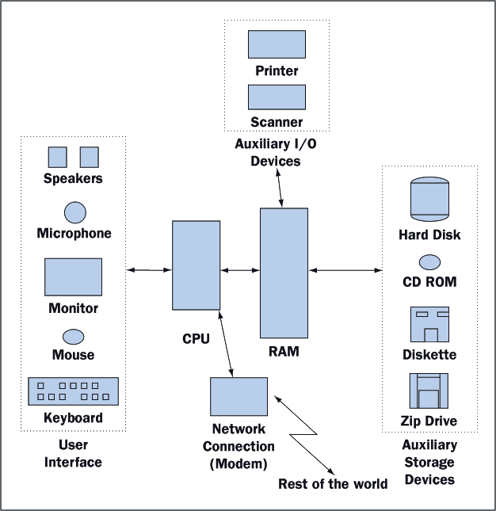
1.2 Computer Hardware and Software

Slide 15
1.2 Computer Hardware and Software
Software
Computer software processes complex patterns of 0s and 1s and transforms them to be viewed as text, images, etc.

Slide 16
1.2 Computer Hardware and Software
Software
Two broad categories of software:
  System Software:
    supports the basic operations of a computer
    allows users to transfer information to and from the computer
      Examples: OS, Compilers, Communications Software, User Interface Subsystem
  Application Software:
    allows users to accomplish specialized tasks
      Examples: Word Processors, Spreadsheets, Database systems, Other programs we write

Slide 17
1.3 Binary Representation of Information and Computer Memory
Examine how different types of information are represented in binary notation.
  Integers
  Floating Point Numbers
  Characters and Strings
  Images
  Sound
  Program Instructions
  Computer Memory

Slide 18
1.3 Binary Representation of Information and Computer Memory
Example: Analyze the meaning of 10011₂, where the subscript 2 indicates that base 2 is being used
10011² = (1*2⁴) + (0*2³) + (0*2²) + (1*2¹) + (1*2⁰)
= 16 + 0 + 0 + 2 + 1 = 19
= (1*10¹) + (9*10⁰)

Slide 19
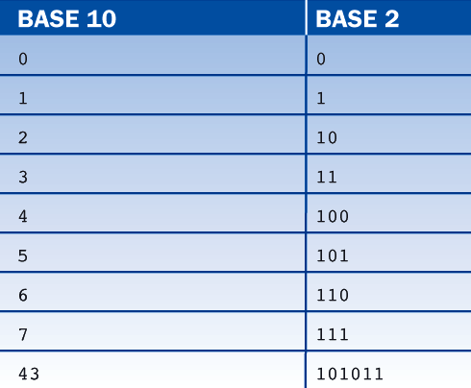
1.3 Binary Representation of Information and Computer Memory
Table 1-1 shows some base 10 numbers and their base 2 equivalents.

Slide 20
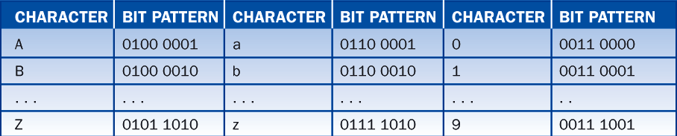
1.3 Binary Representation of Information and Computer Memory
Table 1-2 displays some characters and their corresponding ASCII bit patterns.

Slide 21
1.3 Binary Representation of Information and Computer Memory
Examine how different types of information are represented in binary notation.
  Integers
  Floating Point Numbers
  Characters and Strings
  Images
  Sound
  Program Instructions
  Computer Memory

Slide 22
1.4 Programming Languages
Generation 1 – Late 1940s to Early 1950s: Machine Languages
  Programmers entered programs and data directly into RAM using 1s and 0s
  Several disadvantages existed:
    Coding was error prone, tedious, and slow
    Modifying programs was extremely difficult
    It was nearly impossible for a person to decipher someone else’s program
    Programs were not portable

Slide 23
1.4 Programming Languages
Generation 2 – Early 1950s to Present: Assembly Languages
  Uses mnemonic symbols to represent instructions and data
  Assembly language is:
    More programmer friendly than machine language
    Tedious to use and difficult to modify
    Since each type of computer has its own unique assembly language, it is not portable

Slide 24
1.4 Programming Languages
Generation 3 – Mid-1950s to Present: High-Level Languages
  Designed to be human friendly – easy to read, write, and understand
  Each instruction corresponds to many instructions in machine language
  Translation to machine language occurs through a program called a ‘compiler’
  Examples: FORTRAN, COBOL, BASIC, C, Pascal, C++, Smalltalk, and Java

Slide 25
1.5 The Software Development Process
Creating high-quality software involves organization, planning and utilizing various diagrammatic conventions
Computer scientists have created a view of the software development process known as the ‘software development life cycle’ (SDLC)
One method is known as the ‘waterfall model’’
    A mistake made in one phase often requires the developer to back up and redo some of the work in the previous phase

Slide 26
1.5 The Software Development Process
The Waterfall Model consists of several phases:
  Customer Request
  Analysis
  Design
  Implementation
  Integration
  Maintenance

Slide 27
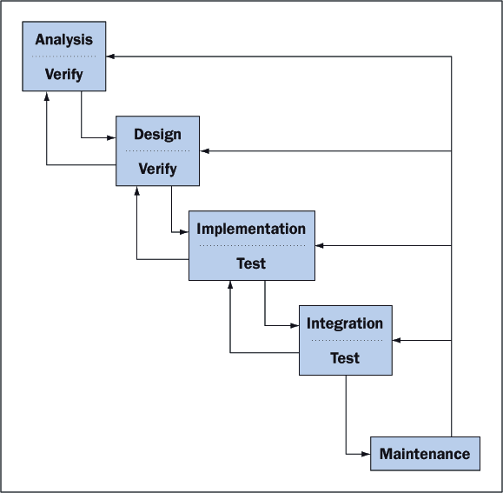
1.5 The Software Development Process
Figure 1-4. The waterfall model of the software development life cycle.

Slide 28
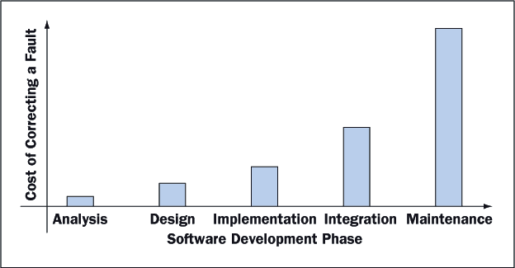
1.5 The Software Development Process
Mistakes found early in the SDLC are much less expensive to correct than those found late.

Slide 29
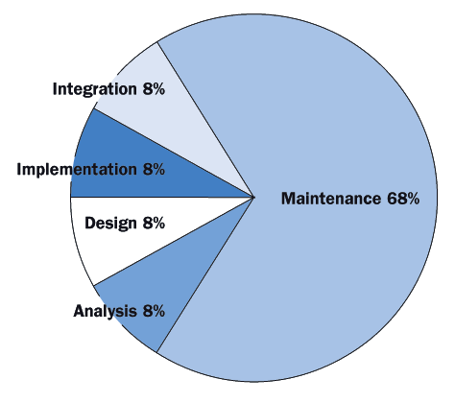
1.5 The Software Development Process
The cost of developing software is not spread equally over the phases. The percentages shown in Figure 1-6 are typical.

Slide 30
1.6 Basic Concepts of
Object-Oriented Programming
High-level programming languages utilize two different approaches
  Procedural approach
    Examples: COBOL, FORTRAN, BASIC, C and Pascal
  Object-oriented approach
    Examples: Smalltalk, C++, and Java

Slide 31
1.6 Basic Concepts of
Object-Oriented Programming
Object-oriented programming (OOP) involves:
  Planning
    Determine your needs
    Create a list of necessary resources
    Establish the rule of behavior to be followed
  Execution
  Outcome

Slide 32
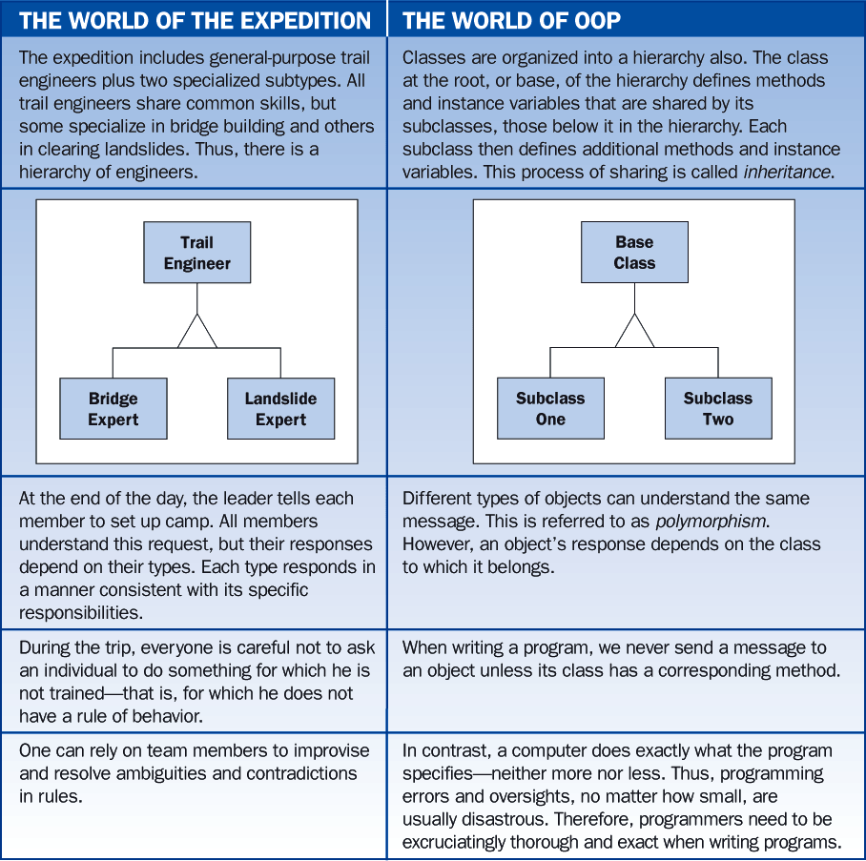
1.6 Basic Concepts of
Object-Oriented Programming
The Expedition analogy to OOP

Slide 33
Lesson 2:
First Java Programs

Slide 34
Lesson 2:
First Java Programs
Objectives:
  Discuss why Java is an important programming language.
  Explain the Java virtual machine and byte code.
  Choose a user interface style.
  Describe the structure of a simple Java program.

Slide 35
Lesson 2:
First Java Programs
Objectives:
  Write a simple program.
  Edit, compile, and run a program using a Java development environment.
  Format a program to give a pleasing, consistent appearance.
  Understand compile-time errors.
  Write a simple turtle graphics program.

Slide 36
Lesson 2:
First Java Programs
Vocabulary:
  applet
  assignment operator
  byte code
  DOS development environment
  graphical user interface (GUI)
  hacking
  integrated development environment (IDE)
  Java virtual machine (JVM)
  just-in-time compilation (JIT)
  parameter
  source code
  statement
  terminal I/O interface
  turtle graphics
  variable

Slide 37
2.1 Why Java?
Java is the fastest growing programming language in the world.
Java is a modern object-oriented programming language.
Java has benefited by learning from the less desirable features of early object-oriented programming languages.

Slide 38
2.1 Why Java?
Java is ideally suited to develop distributed, network-based applications because it:
  Enables the construction of virus-free, tamper-free systems (security)
  Supports the development of programs that do not overwrite memory (robust)
  Yields programs that can be run on different types of computers without change (portable)

Slide 39
2.1 Why Java?
Java supports advanced programming concepts such as threads.
  A thread is a process that can run concurrently with other processes.
Java resembles C++, the world’s most popular industrial strength programming language.
Java however, runs more slowly than most modern programming languages because it is interpreted.

Slide 40
2.2 The Java Virtual Machine and Byte Code
Java compilers translate Java into pseudomachine language called java byte code.
To run java byte code on a particular computer, a Java virtual machine (JVM) must be installed.

Slide 41
2.2 The Java Virtual Machine and Byte Code
A Java virtual machine is a program that acts like a computer. It is called an interpreter.
Disadvantage:
  Runs more slowly than an actual computer
    To combat slower processing, some JVMs translate code when first encountered. This is known as just-in-time compilation (JIT).

Slide 42
2.2 The Java Virtual Machine and Byte Code
Advantages:
  Portability. Any computer can run Java byte code.
  Applets. Applets are small Java programs already translated into byte code.
    Applets run in a JVM incorporated in a web browser
    Applets can be decorative (like animated characters on a web page.)
    Applets can be practical (like continuous streams of stock market quotes.)
  Security. It is possible to limit the capabilities of a Java program since it runs inside a virtual machine.

Slide 43
2.3 Choosing a User Interface Style
There are two types of user interfaces available to use to create Java programs.
  Graphical User Interface (GUI)
  Terminal I/O interface
Figure 2-1 illustrates both interfaces used to create the same program.

Slide 44
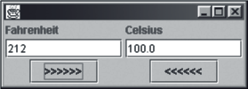

2.3 Choosing a User Interface Style

Slide 45
2.3 Choosing a User Interface Style
There are 3 reasons for beginning with terminal I/O:
  It is easier to implement than a GUI
  There are programming situations that require terminal I/O
  Terminal-oriented programs are similar in structure to programs that process files of sequentially organized data. (What is learned here is easily transferred to that setting.)

Slide 46
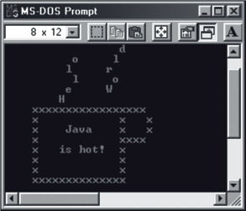
2.4 Hello World
Figure 2-2 displays the results of a small Java program, entitled “hello world”

Slide 47
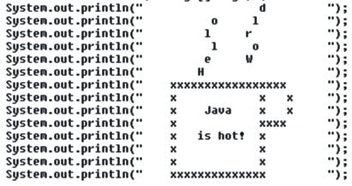
2.4 Hello World
A program is a sequence of instructions for a computer.
The following is the bulk of instructions, or source code, for the “hello world” program.

Slide 48
2.4 Hello World
Sending messages to objects always takes the following form:
<name of object>.<name of message>(<parameters>)

Slide 49
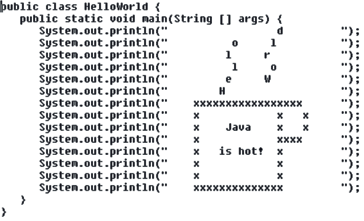
2.4 Hello World
The original “hello world” program needs to be embedded in a larger framework defined by several additional lines of code, in order to be a valid program.

Slide 50
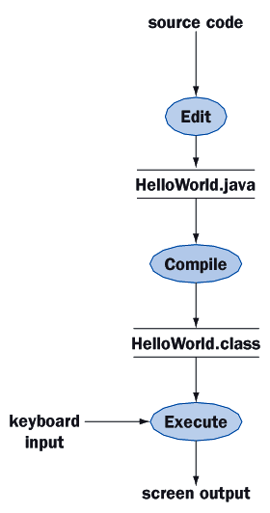
2.5 Edit,
Compile, and Execute
Figure 2-3 illustrates the edit, compile and execute steps.

Slide 51
2.5 Edit,
Compile, and Execute
Development environments:
  Unix
    standard text editor
    command line activation of compiler and JVM
  DOS, using Microsoft Windows and NT OS
    notepad text editor
    command line activation of compiler and JVM from a DOS window
  Integrated development environment, using Windows, NT, or MAC OS
    Examples: Symantec’s Visual Café, Microsoft’s Visual J++, or Borland’s J Builder

Slide 52
2.5 Edit,
Compile, and Execute
Preparing your development environment:
  Create a directory, open a terminal window, use the cd command to move to your new directory
  Open notepad, create the file HelloWorld.java, type in the lines of code
  Save the file, go back to the terminal window, compile the program
  Run the program

Slide 53
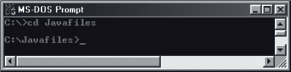

2.5 Edit,
Compile, and Execute
The following figures illustrate the steps necessary for preparing your development environment.

Slide 54
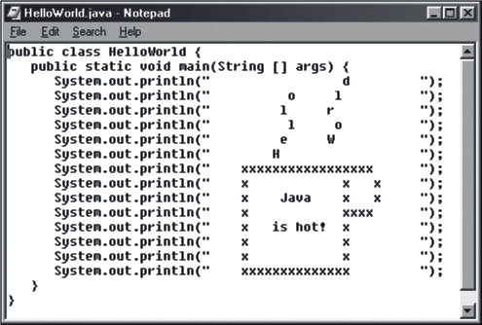
2.5 Edit,
Compile, and Execute

Slide 55
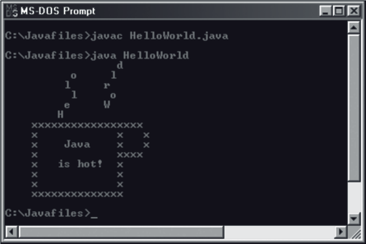
2.5 Edit,
Compile, and Execute

Slide 56
2.6 Temperature Conversion
View the program’s source code:
import TerminalIO.KeyboardReader;
public class Convert {
Public static void main (String [ ] args) {
KeyboardReader reader = new KeyboardReader();
double fahrenheit;
double celsius;
System.out.print(“Enter degrees Fahrenheit: “);
fahrenheit = reader.readDouble();
celsius = (Fahrenheit – 32.0) * 5.0 / 9.0;
System.out.print(“The equivalent in Celsius is “);
System.out.println(celsius);
reader.pause();
}
}

Slide 57
2.6 Temperature Conversion
The following is an explanation of the program code:
  Import statement
  Instantiate or create an object
  Declare the variables
  Position the cursor after “Enter degrees Fahrenheit”
  Assignment operators
  Assignment statements are evaluated
  Print text (and position the cursor)
  Print the value of the variable
  Statement to prevent the terminal window from disappearing from the display (optional, only needed with certain development environments)

Slide 58
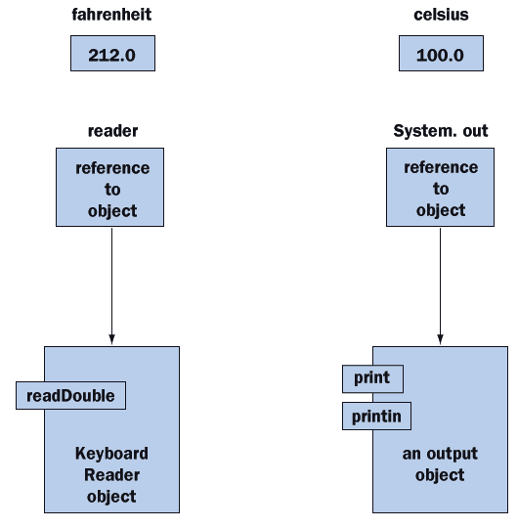
2.6 Temperature Conversion
Figure 2-11 depicts the variables and objects used in the program:

Slide 59
2.7 Turtle Graphics
Turtle graphics:
  Allow programmers to draw pictures in a window
  Enable messages to be sent to an object
  Were developed by MIT in the late 1960s
  The name suggests how to think about objects being drawn by imagining a turtle crawling on a piece of paper with a pen tied to its tail

Slide 60
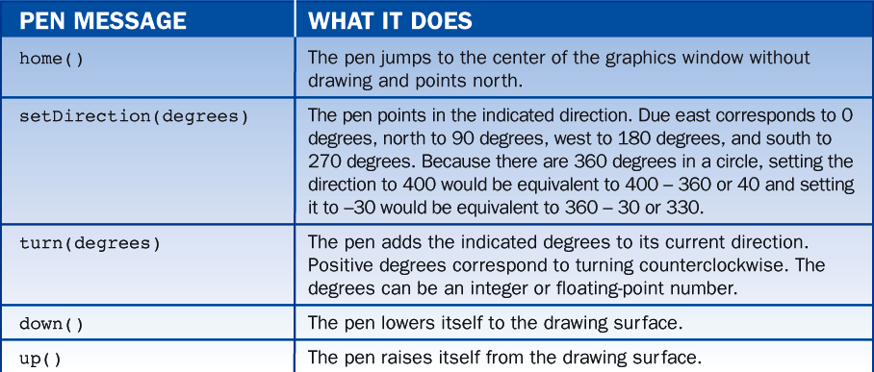
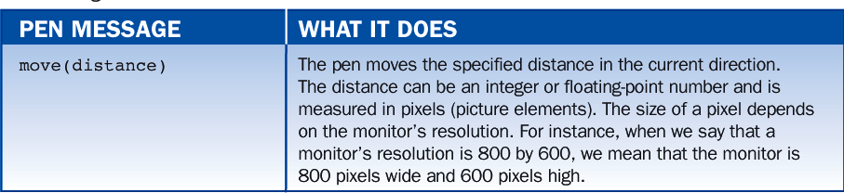
2.7 Turtle Graphics
Table 2-1 displays some pen messages and what they do.

Slide 61

2.7 Turtle Graphics
The following program draws a square, 50 pixels on a side, at the center of the graphics window:
import TurtleGraphics.StandardPen;
public class DrawSquare {
public static void main (String [] args) {
// Instantiate a pen object
StandardPen pen = new StandardPen();
// Lift the pen, move it to the square’s top left corner and lower it again
pen.up();
pen.move(25);
pen.turn(90); pen.move(25);
pen.down();
//Draw the square
pen.turn(90); pen.move(50);
pen.turn(90); pen.move(50);
pen.turn(90); pen.move(50);
pen.turn(90); pen.move(50);
}
}

Slide 62
Lesson 3:
Syntax, Errors, and Debugging

Slide 63
Lesson 3: Syntax,
Errors, and Debugging
Objectives:
  Construct and use numeric and string literals.
  Name and use variables and constants.
  Create arithmetic expressions.
  Understand the precedence of different arithmetic operators.
  Concatenate two strings or a number and a string.
  Know how and when to use comments in a program.
  Tell the difference between syntax errors, run-time errors, and logic errors.
  Insert output statements to debug a program.

Slide 64
Lesson 3: Syntax,
Errors, and Debugging
Vocabulary:
  arithmetic expression
  comments
  exception
  literal
  logic error
  package
  pseudocode
  reserved words
  run-time error
  semantics
  syntax
  virus

Slide 65
3.1 Language Elements
Language elements:
  Vocabulary:
    The words and symbols in the language.
  Syntax:
    The rules for combining words into statements.
  Semantics:
    Define the rules for interpreting statements.

Slide 66
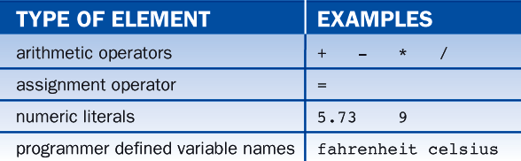
3.1 Language Elements
Table 3-1 displays some Java vocabulary

Slide 67
3.1 Language Elements
Programming Languages vs. Natural Languages:
  Size:
    Programming languages have small vocabularies and simple syntax and semantics.
    Basic elements are not hard to learn.
  Rigidity:
    In programming languages, the syntax used must be absolutely correct.
  Literalness:
    Since computers follow instructions in a very literal manner, a programmer must be exhaustively thorough.

Slide 68
3.2 Basic Java
Syntax and Semantics
Data Types:
  Primitive data types
    Combined in expressions
    Use operators (addition and multiplication)
  Objects
    Are sent messages
    Must be instantiated before use
  Strings
    Are objects
    Are sent messages
    Do not need to be instantiated
    Can be combined using the concatenation operator

Slide 69
3.2 Basic Java
Syntax and Semantics
Syntax:
  Primitive Data Types
    Combined in expressions using operators
  Objects
    Sent messages
    Must be instantiated before used (except stings)
    Stings can be combined using the concatenation operator

Slide 70
3.2 Basic Java
Syntax and Semantics
Numeric Data Types:
  6 numeric data types are used in Java:
    int (integer)
    double (floating-point numbers or numbers with decimals)
    short
    long
    byte
    float

Slide 71
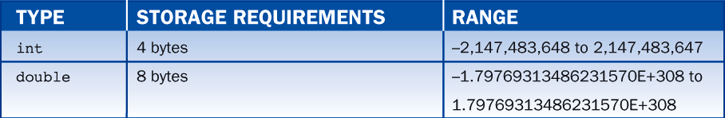
3.2 Basic Java
Syntax and Semantics
Table 3-2 shows some Java numeric data types:

Slide 72
3.2 Basic Java
Syntax and Semantics
Numeric Data Types:
  Programs that manipulate numeric data types often share a common format:
    Input numeric data
    Perform calculations
    Output numeric results

Slide 73
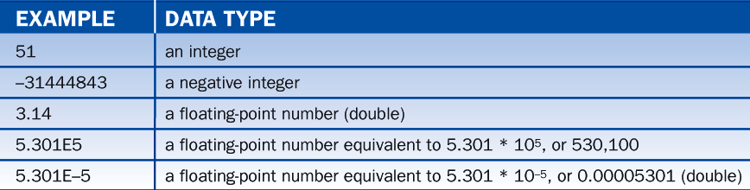
3.2 Basic Java
Syntax and Semantics
Literals:
  Literals are items in a program whose values do not change.
  Table 3-3 lists some examples of numeric literals.

Slide 74
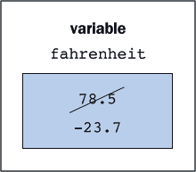
3.2 Basic Java
Syntax and Semantics
Variables and Their Declarations:
  A variable is an item whose value can change during the execution of a program.
  Changing the value of a variable is equivalent to replacing the value that was in the cell with another value.
  The type of data a variable contains cannot change.

Slide 75
3.2 Basic Java
Syntax and Semantics
Declarations
  Variables
    Before using a variable for the first time, the program must declare its type.
    Declare a variable in a variable declaration statement
        int age;
        double celsius;
        String name;
        KeyboardReader reader;
    The type appears on the left and the variable’s name on the right
      Celsius is a double

Slide 76
3.2 Basic Java
Syntax and Semantics
    Several variables can be declared in a single declaration.
    Initial values can be assigned simultaneously to variable declarations:
      int x, y, z = 7;
      double p, q = 1.41, pi = 3.14, t;
      String name = “Bill Jones”;
      KeyboardReader reader = new KeyboardReader();

Slide 77
3.2 Basic Java
Syntax and Semantics
  Objects
    Declare the object variable reader, instantiate or create a KeyboardReader object, and assign the object to the variable.
      New <name of class>()
  Constants
    The value of the variable cannot change
      Final double SALES_TAX_RATE =7.85;
    “final” indicates a variable is declared as a constant
    Names of constants are written in uppercase
    Changing the value of a constant after it is initialized will be flagged by the compiler as an error.

Slide 78
3.2 Basic Java
Syntax and Semantics
Assignment Statements
  An assignment statement has the following form:
      <variable> = <expression>;
  The value of the expression on the right is assigned to the variable on the left:
      double celsius, fahrenheit;
      String name;
      StandardPen pen;

Slide 79
3.2 Basic Java
Syntax and Semantics
Arithmetic Expressions
  An arithmetic expression consists of operands and operators combined in a manner familiar from algebra. The usual rules apply:
    Multiplication and division are evaluated before addition and subtraction.
    Operators of equal precedence are evaluated from left to right.
    Parentheses can be used to change the order of evaluation.

Slide 80
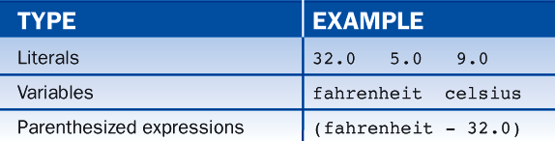
3.2 Basic Java
Syntax and Semantics
  Multiplication must be indicated explicitly
  (a * b cannot be written as ab)
  Binary operators are placed between their operands (a * b)
  Unary operators are placed before their operands (-a)

Slide 81
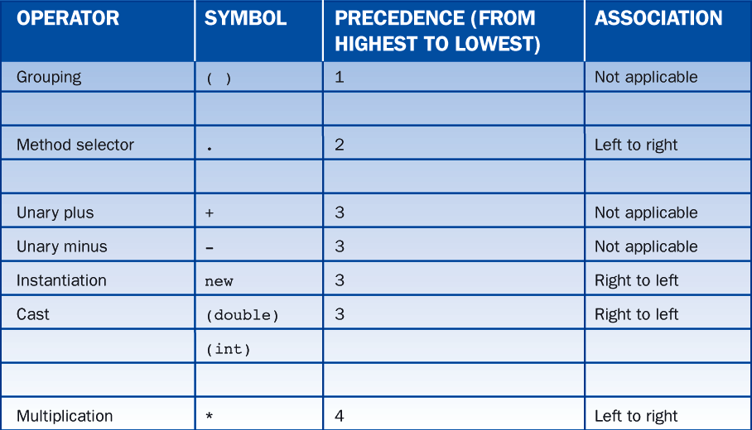
3.2 Basic Java
Syntax and Semantics
Common operators and their precedence:

Slide 82
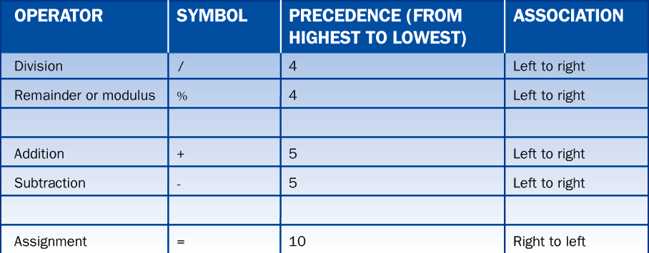
3.2 Basic Java
Syntax and Semantics

Slide 83
3.2 Basic Java
Syntax and Semantics
Division:
  Several points concerning operators need explanation. First, the semantics of division are different for integer and floating-point operands. Thus:
      5.0/2.0 yields 2.5
      5/2 yields 2 (a quotient in which the fractional portion of the answer is simply dropped)
Modulus:
  The operator % yields the remainder obtained when one number is divided by another. Thus:
      9 % 5 yields 4
      9.3 % 5.1 yields 4.2

Slide 84
3.2 Basic Java
Syntax and Semantics
Precedence:
When evaluating an expression, Java applies operators of higher precedence before those of lower precedence unless overridden by parentheses. The highest precedence is 1.
      3+5*3 yields 18
      -3+5*3 yields 12
      +3+5*3 yields 18 (use of unary + is uncommon)
      3+5*-3 yields -12
      3+5*+3 yields 18 (use of unary – is uncommon)
      (3+5)*3 yields 24
      3+5 % 3 yields 5
      (3+5) % 3 yields 2

Slide 85
3.2 Basic Java
Syntax and Semantics
Association:
  The column labeled “Association” in Table 3-5 indicates the order in which to perform operations of equal precedence. Thus:
      18-3-4 yields 11
      18/3*4 yields 24
      18 % 3*4 yields 0
      a=b=7; assigns 7 to b and b to a
More Examples
  More examples of expressions and their values are shown in Table 3-6. In this table, we see the application of two fairly obvious rules governing the use of parentheses
      Parentheses must occur in matching pairs
      Parenthetical expressions may be nested but must not overlap.

Slide 86
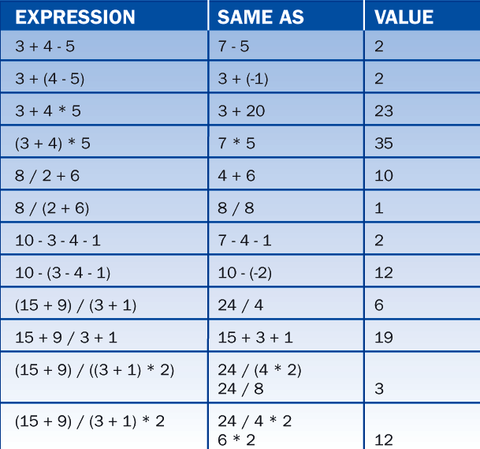
3.2 Basic Java
Syntax and Semantics

Slide 87
3.2 Basic Java
Syntax and Semantics
Mixed-Mode Arithmetic
  Intermixing integers and floating-point numbers is called mixed-mode arithmetic.
  When binary operations occur on operands of different numeric types, the less inclusive type (int) is temporarily and automatically converted to the more inclusive type (double) before the operation is performed.

Slide 88
3.2 Basic Java
Syntax and Semantics
  Mixed-mode assignments are also allowed, provided the variable on the left is of a more inclusive type than the expression on the right. Otherwise, a syntax error occurs.
    double d;
    int i;
    i = 45; --OK, because we assign an int to an int
    d = i; --OK, because d is more inclusive than i. The value 45.0 is stored in d.
    i = d; --Syntax error because i is less inclusive than d.
  Difficulties associated with mixed-mode arithmetic can be circumvented using a technique called “casting”. This allows one data type to be explicitly converted to another

Slide 89
3.2 Basic Java
Syntax and Semantics
String Expressions and Methods
  Simple Concatention
    The concatention operator uses the plus symbol (+)
      String firstName, //declare four string
      lastName, //variables
      fullName,
      lastThenFirst;
      firstName = “Bill”; //initialize firstName
      lastName = “Smith”; //initialize lastName
      fullName = firstName +” “ + lastName; //yields “Bill Smith”
      lastThenFirst = lastName +”, “+ firstName; //yields “Smith, Bill”

Slide 90
3.2 Basic Java
Syntax and Semantics
  Concatenating Strings and Numbers
    Strings also can be concatenated to numbers. (The number is automatically converted to a string before the concatenation operator is applied.)
      String message;
      int x = 20, y = 35;
      message = “Bill sold ” + x + “ and Sylvia sold ” + y + “ subscriptions.”;
      // yields “Bill sold 20 and Sylvia sold 35 subscriptions.”

Slide 91
3.2 Basic Java
Syntax and Semantics
  Precedence of Concatenation
    The concatenation operator has the same precedence as addition, which can lead to unexpected results:
    “number ” + 3 + 4 -- “number 3” + 4 -- “number 34”
    “number ” + (3 + 4) -- “number ” + 7 -- “number 7”
    “number ” + 3 * 4 -- “number ” + 12 -- “number 12”
    3 + 4 + “number” -- 7 + “number” -- “7 number”

Slide 92
3.2 Basic Java
Syntax and Semantics
Escape Character
  String literals are delimited by quotation marks (“…”), which presents a dilemma when quotation marks are supposed to appear inside a string.
  Placing a special character before the quotation mark, indicating the quotation mark is to be taken literally and not as a delimiter, solves the problem.
  This special character, also called the escape character, is a backslash (\).
    Message = “As the train left the station, ” +
      “the conductor yelled, \”All aboard.\””;

Slide 93
3.2 Basic Java
Syntax and Semantics
Escape Character
  The escape character also is used when including other special characters in string literals.
  Special sequences involving the backslash character are called escape sequences
  Backslash – t (\t) indicates a tab character
      Backslash – n (\n) indicates a newline character
  When a string must contain a backslash, use two backlashes in sequence to escape the escape character.
      Path = “c:\\Java\\Ch3.doc”;
      -- yields the string C:\Java\Ch3.doc

Slide 94
3.2 Basic Java
Syntax and Semantics
The length Method
  Strings are objects and implement several methods.
  A string returns its length in response to a length message:
    String theString;
    int theLength;
    theString = “the cat sat on the mat.”;
    the Length = theString.length(); -- yields 23

Slide 95
3.2 Basic Java
Syntax and Semantics
Methods, Messages, and Signatures
  Classes implement methods, and objects are instances of classes.
  An object responds to a message only if its class implements a corresponding method.
  To correspond the method must have the same name as the message.
    Messages are sometimes accompanied by parameters and sometimes not:
      pen.down(); // No parameter expected
      pen.move(50.5); // One parameter expected

Slide 96
3.2 Basic Java
Syntax and Semantics
  The parameters included when a message is sent must match exactly in number and type the parameters expected by the method.
    Double d = 24.6;
    pen.move (d); // Perfect! A parameter of type double is expected
    pen.move (2.0 * d); // Perfect! The expression yields a double.
    pen.move (4); // Fine! Integers can stand in for doubles.
    pen.move ( ); // Error! A parameter is needed.
    pen.move (6.7, 3.4); // Error! One parameter only please.
    pen.move (“far”); // Error! A string parameter is NOT acceptable.

Slide 97
3.2 Basic Java
Syntax and Semantics
  Some methods return a value and others do not.
  To use a method successfully we must know:
    What type of value it returns
    It’s name
    The number and type of the parameters it expects
  This information is called the method’s signature.

Slide 98
3.2 Basic Java
Syntax and Semantics
  Keywords
    Keywords or reserved words cannot be employed as user-defined symbols because they have special meaning in Java.
    Keywords are also case sensitive. “import” is a reserved word but “Import” and “IMPORT” are not.

Slide 99
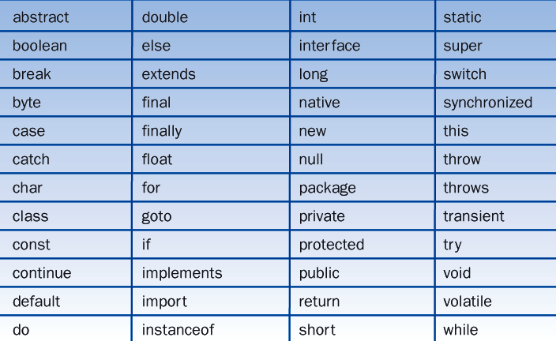
3.2 Basic Java
Syntax and Semantics
Table 3-7 displays a list of Java’s reserved words

Slide 100
3.2 Basic Java
Syntax and Semantics
Programming Protocols:
    Well-chosen variables names greatly increase a program’s readability and maintainability
    It is considered good programming practice to use meaningful names such as:
        radius rather than r
        taxableIncome rather than ti
    Examples of valid and invalid variable names:
    Valid Names: surfaceArea3 _$_$$$
      Invalid Names: 3rdPayment pay.rate abstract

Slide 101
3.2 Basic Java
Syntax and Semantics
Programming Protocols:
    When forming a compound variable name, programmers usually capitalize the first letter of each word except the first.
    (For example: taxableIncome)
    All the words in a program’s name typically begin with a capital letter (ComputeEmployeePayroll).
    Constant names usually are all uppercase (CONSTANTNAME).

Slide 102
3.2 Basic Java
Syntax and Semantics
Packages and the import statement
  Java often utilizes code written by many other programmers.
  A package makes it easy for programmers to share code.
  A programmer can collect the classes together in a package, and then import classes from the package.
  The Java programming environment typically includes a large number of standard packages.
  When using a package, a programmer imports the desired class or classes.

Slide 103
3.2 Basic Java
Syntax and Semantics
  The general form of an import statement is:
    import x.y.z;
    where
    x is the overall name of the package.
    y is the name of a subsection within the package.
    z is the particular class in the subsection.
  It is possible to import all the classes within a subsection at once.
  The statement to import all the classes within a subsection looks like this:
    import x.y.*;
  A star (*) is used to make available all of the classes in a package.

Slide 104
3.3 Terminal I/O for
Different Data types
  Objects support terminal input and output.
  An instance of the class Keyboardreader supports input.
  The object System.out supports output.
  Object System.out is an instance of the class PrintStream.
  This class, together with a number of others, is available to Java programmers without specifying their names in import statements.

Slide 105
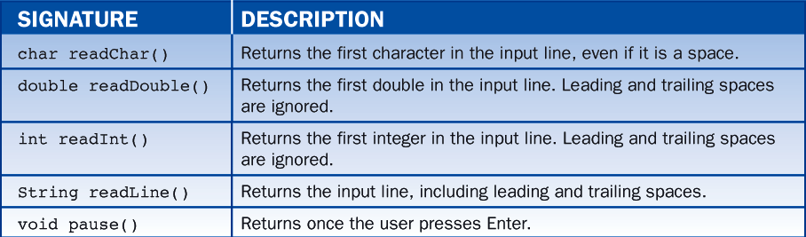
3.3 Terminal I/O for
Different Data types
Table 3-8 summarizes the methods in class KeyboardReader.

Slide 106
3.3 Terminal I/O for
Different Data types
The following program illustrates the major features of terminal I/O:
import TerminalIO.KeyboardReader;
public class TestTerminalIO {
public static void main (String [] args) {
KeyboardReader reader = new KeyboardReader();
String name;
int age;
double weight;
System.out.print ("Enter your name (a string): ");
name = reader.readLine();
System.out.print ("Enter your age (an integer): ");
age = reader.readInt();

Slide 107
3.3 Terminal I/O for
Different Data types
System.out.print ("Enter you weight (a double): ");
weight = reader.readDouble();
System.out.println ("Greetings " + name +
". You are " + age +
" years old and you weigh " + weight + " pounds.");
reader.pause();
}
}

Slide 108
3.4 Comments
  Comments are explanatory sentences inserted in a program in such a matter that the compiler ignores them.
  There are two styles for indicating comments:
    End of line comments:
    These include all of the text following a double slash (//) on any given line; in other words, this style is best for just one line of comments
    Multiline comments:
    These include all of the text between an opening /* and a closing */

Slide 109
3.4 Comments
  The following code segment illustrates the use of both kinds of comments.
    /* This code segment illustrates the
    use of assignment statements and comments */
    a = 3; // assign 3 to variable a
    b = 4; // assign 4 to variable b
    c = a + b; // add the number in variable a
    // to the number in variable b
    // and assign the result, 7 , to variable c

Slide 110
3.4 Comments
  The main purpose of comments is to make a program more readable and thus easier to maintain.
  One should:
    Begin a program with a statement of its purpose and other information that would help orient a programmer called on to modify the program at some future date.
    Accompany a variable declaration with a comment that explains the variable’s purpose.
    Precede major segments of code with brief comments that explain their purpose.
    Include comments to explain the workings of complex or tricky sections of code.

Slide 111
3.4 Comments
  Too many comments are as harmful as too few, because over time, the burden of maintaining the comments becomes excessive.
  The best written programs are self-documenting; that is, the reader can understand the code from the symbols used and from the structure and overall organization of the program.

Slide 112
3.5 Programming Errors
The Three Types of Errors
  Syntax errors
    Occur when a syntax rule is violated (no matter how minor)
    Are detected at compile time.
    When the Java compiler finds a syntax error, it prints an error message.
    Error messages are often quite cryptic.

Slide 113
3.5 Programming Errors
  Run-time errors
    Occur when the computer is asked to do something that it considers illegal, (such as dividing by zero)
    x/y is syntactically correct
    When the expression is evaluated during execution of the program, the meaning of the expression depends on the values contained in the variables.
      (If the variable y has the value 0, then the expression cannot be evaluated)
    The Java run-time environment will print a message telling us the nature of the error and where it was encountered.
    The error message might be hard to understand.

Slide 114
3.5 Programming Errors
  Logic errors (design errors or bugs)
    Occur when we fail to express ourselves accurately.
      The instruction is phrased properly, and thus the syntax is correct.
      The instruction is meaningful, and thus the semantics are valid.
      But the instruction does not do what we intended, and thus is logically incorrect.
    Programming environments do not detect logic errors automatically.

Slide 115
3.6 Debugging
  A bug is not always easy to locate.
  Often bugs are not located where one might expect them.
  Adding extra lines to the program can help to locate a bug.
  Determining if any of the variables deviate from their expected values will highlight the existence of a bug.
  A variables value is printed in the terminal window as follows:
    System.out.println (“<some message>” +
    <variable name>);

Slide 116
3.6 Debugging
  The following program claims that 212 degrees Fahrenheit converts to 41.1 degrees Celsius instead of the expected 100.
  Try checking the value of fahrenheit just before celsius is calculated. The needed code looks like this:
    System.out.println (“fahrenheit = ” + fahrenheit); --- This is the debugging code
    celsius = (Fahrenheit - 32.0) * 5.0 / 9.0;

Slide 117
3.6 Debugging
  When the program runs again with the debugging code included, we get the following output:
      Enter degrees Fahrenheit: 212
      Fahrenheit = 106.0
      The equivalent in celsius is 41.111111111111114
  212 is entered but for some reason, the program says the value of fahrenheit is 106.

Slide 118
3.6 Debugging
  Examine the surrounding code to try to spot the error.
      . . .
      System.out.print (“Enter degrees Fahrenheit: ”);
      fahrenheit = reader.readDouble( ) / 2.0
      System.out.println (“fahrenheit = ” + fahrenheit);
      celsius = (fahrenheit – 32.0) * 5.0 / 9.0
      . . .
  The error is that the value enterd by the user is divided by 2 just before it is assigned to the variable fahrenheit.

Slide 119
Lesson 4:
Introduction to
Control Statements

Slide 120
Lesson 4: Introduction to Control Statements
Objectives:
  Use the increment and decrement operators.
  Use standard math methods.
  Use if and if-else statements to make choices.
  Use while and for loops to repeat a process.
  Construct appropriate conditions for control statements using relational operators.
  Detect and correct common errors involving loops.

Slide 121
Lesson 4: Introduction to Control Statements
Vocabulary:
  control statements
  counter
  count-controlled loop
  flowchart
  infinite loop
  iteration
  off-by-one error
  overloading
  random walk
  sentinel
  task-controlled loop

Slide 122
4.1 Additional Operators
Extended Assignment Operators
  The assignment operator can be combined with the arithmetic and concatenation operators to provide extended assignment operators. For example
      int a = 17;
      String s = “hi”;
      a + = 3; // Equivalent to a = a + 3;
      a -= 3; // Equivalent to a = a – 3;
      a *= 3; // Equivalent to a = a * 3;
      a /= 3; // Equivalent to a = a / 3;
      a %= 3; // Equivalent to a = a % 3;
      S += “ there”; // Equivalent to s = s + “ there”;

Slide 123
4.1 Additional Operators
  Extended assignment operators can have the following format.
      variable op= expression;
      which is equivalent to
      variable = variable op expression;
  Note that there is no space between op and =.
  The extended assignment operators and the standard assignment have the same precedence.

Slide 124
4.1 Additional Operators
Increment and Decrement
  Java includes increment (++) and decrement (--) operators that increase or decrease a variables value by one:
      int m = 7;
      double x = 6.4;
      m++; // Equivalent to m = m + 1;
      x--; // Equivalent to x = x – 1.0;
  The precedence of the increment and decrement operators is the same as unary plus, unary minus, and cast.

Slide 125
4.2 Standard
Classes and Methods
The Math Class
  Notice that two methods in the table are called abs. They are distinguished from each other by the fact that one takes an integer and the other takes a double parameter.
  Using the same name for two different methods is called overloading

Slide 126
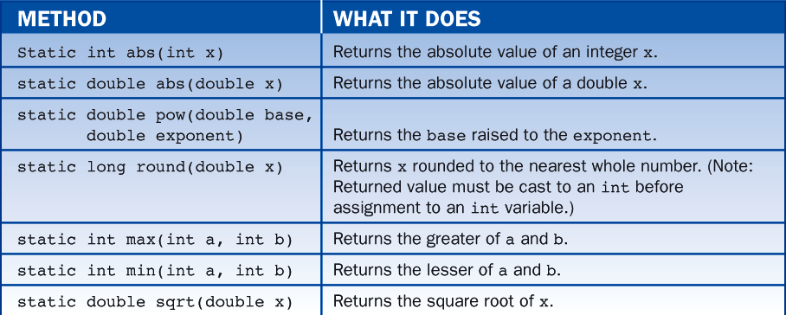
4.2 Standard
Classes and Methods
Seven methods in the Math Class

Slide 127
4.2 Standard
Classes and Methods
The sqrt Method
  This code segment illustrates the use of the sqrt method:
    // Given the area of a circle, compute its radius
    // Use the formula a = πr² , where a is the area and
    // r is the radius
    double area = 10.0, radius;
    radius = Math.sqrt (area / Math.PI);
  Messages are usually sent to objects; however, if a method’s signature is labeled static, the message instead is sent to the method’s class.

Slide 128
4.2 Standard
Classes and Methods
The sqrt Method
  Thus, to invoke the sqrt method, we send the sqrt message to the Math class.
  In addition to methods, the Math class includes good approximations to several important constants.
  Math.PI is an approximation for π accurate to about 17 decimal places.

Slide 129
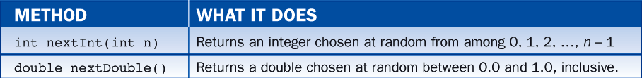
4.2 Standard
Classes and Methods
The Random Class
  A random number generator returns numbers chosen at random from a predesignated interval.
  Java’s random number generator is implemented in the Random class and utilizes the methods nextInt and nextDouble as described in table 4-2.
  A program that uses the Random class first must import java.util.Random.
    Import java.util.Random

Slide 130
4.3 A Shortcut for
Inputting data
  Prompts can be passed as parameters to read messages.
    For Example:
      fahrenheit = reader.readDouble (“Enter degrees Fahrenheit: ”);

Slide 131
4.4 Control Statements
  While and if-else are called control statements.
    For example:
      while (some condition) {
      do stuff;
    Means do the stuff repeatedly as long as the condition holds true
    o
      do stuff 1;
      }else {
      do stuff 2;
    Means if some condition is true, do stuff 1, and if it is false, do stuff 2.
while (some condition){
do stuff;
}
if (some condition){
do stuff 1;
}else{
do stuff 2;
}

Slide 132
4.5 The if and if-else Statements
Principal Forms
  In Java, the if and if-else statements allow for the conditional execution of statements.
if (condition){
statement; //Execute these statements if the
statement; //condition is true.
}
if (condition){
statement; //Execute these statements if the
statement; //condition is true.
}else{
statement; //Execute these statements if the
statement; //condition is false.
}

Slide 133
4.5 The if and if-else Statements
  The indicated semicolons and braces are required
  Braces always occur in pairs
  There is no semicolon immediately following a closing brace.

Slide 134
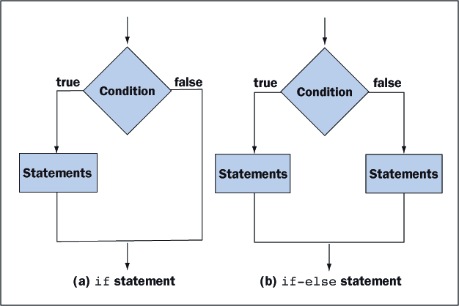
4.5 The if and if-else Statements
Figure 4-1 shows a diagram called a flowchart that illustrates the behavior of if and if-else statements.

Slide 135
4.5 The if and if-else Statements
Examples:
// Increase a salesman’s commission by 10% if his sales are over $5000
if (sales > 5000)
commission *= 1.1;
// Pay a worker $14.5 per hour plus time and a half for overtime
pay = hoursWorked * 14.5;
if (hoursWorked > 40){
overtime = hoursWorked - 40;
pay += overtime * 7.25;
}
// Let c equal the larger of a and b
if (a > b)
c = a;
else
c = b;

Slide 136
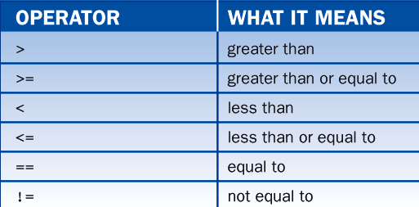
4.5 The if and if-else Statements
Relational Operators
Table 4-3 shows the complete list of relational operators available for use in Java.

Slide 137
4.5 The if and if-else Statements
  The double equal signs (==) distinguish the equal to operator from the assignment operator (=).
  In the not equal to operator, the exclamation mark (!) is read as not.

Slide 138
4.6 The while Statement
  The while statement provides a looping mechanism that executes statements repeatedly for as long as some condition remains true.
      while (condition) //loop test
      statement; //one statement inside the loop body
      while (condition) { //loop test
      statement; //many statements
      statement; //inside the
      ... //loop body
      }

Slide 139
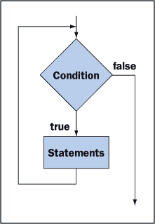
4.6 The while Statement
  If the condition is false from the outset, the statement or statements inside the loop never execute. Figure 4-2 uses a flowchart to illustrate the behavior of a while statement.

Slide 140
4.6 The while Statement
Compute 1+2+…+100 (Count-controlled Loops)
  The following code computes and displays the sum of the integers between 1 and 100, inclusive:
  // Compute 1 + 2 + … + 100
  int sum = 0, cntr = 1;
  while (cntr ,= 100) {
  sum += cntr; //point p (we refer to this location in Table 4-4)
  cntr++; // point q (we refer to this location in table 4-4)
  }
  System.out.println (sum);

Slide 141
4.6 The while Statement
  The variable cntr acts as a counter that controls how many times the loop executes.
  The counter starts at 1.
  Each time around the loop, it is compared to 100 and incremented by 1.
  The code inside the loop is executed exactly 100 times, and each time through the loop , sum is incremented by increasing values of cntr.
  The variable cntr is called the counter.

Slide 142
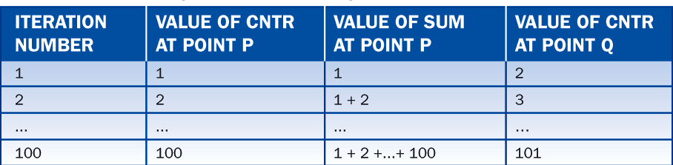
4.6 The while Statement
Tracing the Variables
  To understand the lop fully, we must analyze the way in which the variables change on each pass or iteration through the loop. Table 4-4 helps in this endeavor. On the 100th iteration, cntr is increased to 101, so there is never a 101st iteration, and we are confident that the sum is computed correctly.

Slide 143
4.6 The while Statement
Counting Backwards
  The counter can run backward.
  The next example displays the square roots of the numbers 25, 20, 15, and 10
  Here the counter variable is called number:
    // display the square roots of 25, 20, 15, and 10
    int number = 25;
    while (number >= 10) {
    System.out.println (“The square root of” + number + “is” + Math.sqrt (number));
    number -= 5;
    }

Slide 144
4.6 The while Statement
The output is:
    The square root of 25 is 5.0
    The square root of 20 is 4.47213595499958
    The square root of 15 is 3.872983346207417
    The square root of 10 is 3.1622776601683795

Slide 145
4.6 The while Statement
Task-Controlled Loop
  Task-controlled loops are structured so that they continue to execute until some task is accomplished
  The following code finds the first integer for which the sum 1+2+…+n is over a million:
      // Display the first value n for which 1+2+…+n
      // Is greater than a million
      int sum = 0;
      int number = 0;
      while (sum<= 1000000) {
      number++
      sum += number; // point p
      }
      system.out.println (number);

Slide 146
4.6 The while Statement
Common Structure
  Loops typically adhere to the following structure:
    initialize variables //initialize
    While (condition) { //test
    perform calculations and //loop
    change variables involved in the condition //body
    }
  In order for the loop to terminate, each iteration through the loop must move variables involved in the condition significantly closer to satisfying the condition.

Slide 147
4.7 The for Statement
  The for statement combines counter initialization, condition test, and update into a single expression.
  The form for the statement:
      for (initialize counter; test counter; update counter)
      statement; // one statement inside the loop body
      for (initialize counter; test counter; update counter) {
      statement; // many statements
      statement; //inside the
      . . .; //loop body
      }

Slide 148
4.7 The for Statement
  When the for statement is executed, the counter is initialized.
  As long as the test yields true, the statements in the loop body are executed, and the counter is updated.
  The counter is updated at the bottom of the loop, after the statements in the body have been executed.

Slide 149
4.7 The for Statement
  The following are examples of for statements used in cont-controlled loops:
      // Compute 1 + 2 + … + 100
      int sum = 0, cntr;
      for (cntr = 1; cntr<=100; cntr++)
      sum += cntr;
      System.out.println (sum);
      // Display the square roots of 25, 20, 15, and 10
      int number;
      for (number = 25; number>=10; number-= 5)
      System.out.println (“The square root of” + number +
      “is” + Math.sqrt (number));

Slide 150

4.7 The for Statement
Draw a Spiral
  Below is a for statement that draws a spiral that wraps three times around the pen’s home postion at the center of the graphics window (see figure 4-3):
    StandardPen pen = new StandardPen();
    double stepSize, degreesSo Far;
    stepSize = 0;
    for (degreesSoFar = 0; degreesSoFar <=3 * 360; degreesSoFar += 33) {
    stepSize==;
    pen.move (stepSize);
    pen.turn (33);
    }

Slide 151
4.7 The for Statement
Declaring the Loop Control Variable in a for Loop.
  The for loop allows the programmer to declare the loop control variable inside of the loop header.
  The following are equivalent loops that show these two alternatives:
      int i; //Declare control variable above loop
      for (i = 1; i <= 10; i++)
      System.out.println(i);
      for (int i = 1; i<= 10; i++) //Declare control variable in
      // loop header
      System.out.println(i);

Slide 152
4.7 The for Statement
  Both loops are equivalent in function, however the second alternative is considered preferable on most occasions for two reasons:
    The loop control variable is visible only within the body of the loop where it is intended to be used.
    The same name can be declared again in other for loops in the same program.

Slide 153
4.8 Nested Control Statements and the break Statement
  Control statements can be nested inside each other in any combination that proves useful.
  The break statement can be used for breaking out of a loop early, that is before the loop condition is false.
  Break statements can be used similarly with both, for loops, and while loops.

Slide 154
4.8 Nested Control Statements and the break Statement
Print the Divisors
As a first example, we write a code segment that asks the user for a positive integer n, and then prints all it’s proper divisors, that is, all divisors except one and the number itself. For instance, the proper divisors of 12 are 2, 3, 4 ,and 6. A positive integer d is a divisor of n if d is less than n and n % d is zero. Thus, to find n’s proper divisors, we must try all values of d between 2 and n / 2.

Slide 155
4.8 Nested Control Statements and the break Statement
  Here is the code:
    // Display the proper divisors of a number
    int n = reader.readInt(“Enter a positive integer: ”);
    int limit = n / 2;
    for (int d = 2; d <= limit; d++) {
    if (n % d == 0)
    System.out.print (d + “ “);
    }

Slide 156
4.8 Nested Control Statements and the break Statement
Is a Number Prime?
    A number is prime if it has no proper divisors. We can modify the previous code segment to determine if a number is prime by counting it’s proper divisors. If there are none, the number is prime.
    Here is the code:

Slide 157
4.8 Nested Control Statements and the break Statement
    // determine if a number is prime
    int n = reader.readInt(“Enter an integer greater than 2: ”);
    int count = 0;
    int limit = n / 2;
    for (int d = 2; d <= limit; d++) {
    if (n % d == 0)
    count++;
    }
    if (count != 0)
    System.out.println (“Not prime.”);
    else
    System.out.println (“Prime.”);

Slide 158
4.8 Nested Control Statements and the break Statement
The break Statement
  To get out of a loop before the loop condition is false, a break statement can be used.
  A loop either for or while, terminates immediately when a break statement is executed.
  In the following segment of code, we check d after the for loop terminates. If n has a divisor, the break statement executes, the loop terminates early, and d is less than or equal to the limit.

Slide 159
4.8 Nested Control Statements and the break Statement
    //determine if a number is prime
    int n = reader.readInt(“Enter an integer greater than 2: ”);
    int limit = (int)Math.sqrt (n);
    int d; //Declare control variable here
    for (d = 2; d <= limit; d++) {
    if (n % d == 0)
    break;
    }
    if (d <= limit) //So it’s visible here
    System.out.println (“Not prime.”);
    else
    System.out.println (“Prime.”);

Slide 160
4.9 Errors in Loops
A loop usually has four component parts:
  Initializing Statements.
    These statements initialize variables used within the loop.
  Terminating condition.
    This condition is tested before each pass through the loop to determine if another iteration is needed.
  Body Statements.
    these statements execute on each iteration and implement the calculation in question.

Slide 161
4.9 Errors in Loops
  Update statements.
    These statements, which usually are executed at the bottom of the loop, change the values of the variables tested in the terminating condition.
  A careless programmer can introduce logic errors into any of these components.

Slide 162
4.9 Errors in Loops
Initialization Error
  Because we forget to initialize the variable product, it retains its default value of zero.
    //Error – failure to initialize the variable product
    //Outcome – zero is printed
    i = 3;
    while (i <= 100) {
    product = product * i;
    i = i + 2;
    }
    System.out.println (product);

Slide 163
4.9 Errors in Loops
Off-by-One Error
  The off-by-one error, occurs whenever a loop goes around one too many or one too few times
  This is one of the most common types of looping errors and is often difficult to detect.

Slide 164
4.9 Errors in Loops
  //Error – use of “< 99” rather than “<= 100” in the
  // terminating condition
  //Outcome – product will equal 3 * 5...* 97
  product = 1;
  i = 3;
  while (i < 99) {
  product = product * i;
  i = i +2;
  }
  System.out.println (product);

Slide 165
4.9 Errors in Loops
Infinite Loop
    //Error – use of “!= 100” rather than “<= 100” in
    //the terminating condition.
    // Outcome – the program will never stop
    product = 1;
    i = 3;
    while (i != 100) {
    product = product * i;
    i = i + 2;
    }
    System.out.println (product);

Slide 166
4.9 Errors in Loops
  The variable i takes on the values 3, 5, ...., 99, 101, ... and never equals 100.
  This is called an infinite loop.
  Anytime a program responds more slowly than expected, it is reasonable to assume that it is stuck in an infinite loop.
  To stop the program select the terminal window and type Ctrl+C.

Slide 167
4.9 Errors in Loops
Update Error
  If the update statement is in the wrong place, the calculations can be thrown off even if the loop iterates the correct number of times:
//Error – placement of the update statement in the wrong place
//Outcome – product will equal 5*7*...*99*101
product = 1;
i = 3;
while (i <= 100){
i = i + 2; //this update statement should follow the calculation
product = product * i;
}
System.out.println (product);

Slide 168
4.9 Errors in Loops
Debugging Loops
  If you suspect that you have written a loop that contains a logic error, inspect the code and make sure the following items are true:
    Variables are initialized correctly before entering the loop.
    the terminating condition stops the iterations when the test variables have reached the intended limit.

Slide 169
4.9 Errors in Loops
    The statements in the body are correct.
    The update statements are positioned correctly and modify the test variables in such a manner that they eventually pass the limits tested in the terminating condition.
    When writing terminating conditions, it is usually safer to use one of the operators:
      < <= > >=
      than either of the operators
      == !=

Slide 170
4.9 Errors in Loops
  If you cannot find an error by inspection, then use System.out.println statements to “dump” key variables to the terminal window.
  Good places for these statements are:
    Immediately after the initialization statements.
    Inside the loop at the top.
    Inside the loop at the bottom.
  You will then discover that some of the variables have values different than expected, and this will provide clues that reveal the exact nature and location of the logic error.

